Slide 1
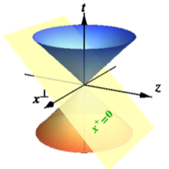


An Introduction to Light-front Quantization
Xingbo Zhao
Institute of Modern Phyics,
Chinese Academy of Sciences
The 7th Summer School on Lattice Gauge Field Theory
Institute of Modern Physics, CAS, Huizhou 2024.8.7

Slide 2
Outline
Introduction
What is light-front quantization
What is Basis Light-front Quantization
Application to proton structure
Conclusions

Slide 3
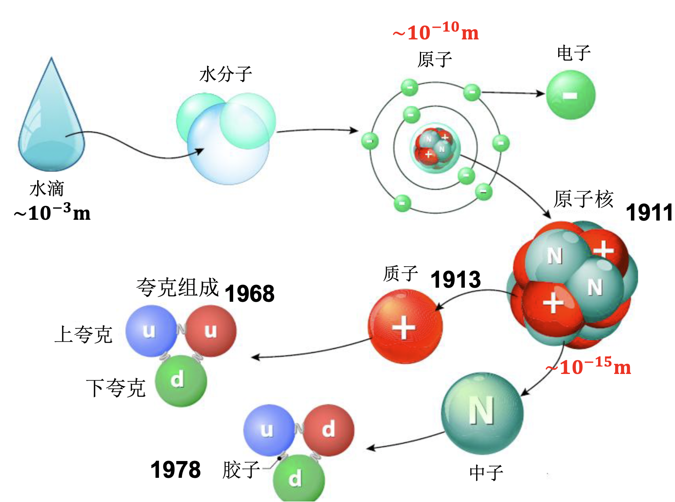
Fundamental Structure of Matter
Quarks and gluons: the smallest building blocks of matter
How nucleon and nuclear structure emerge from their interactions?

Slide 4

Discovery of Proton
Proton was discovered by Rutherford in 1919
¹⁴N + α → ¹⁷O + p
Anomalous magnetic moment not point-like
[Otto Stern, 1933]
If proton were point-like
Exp. value

Slide 5
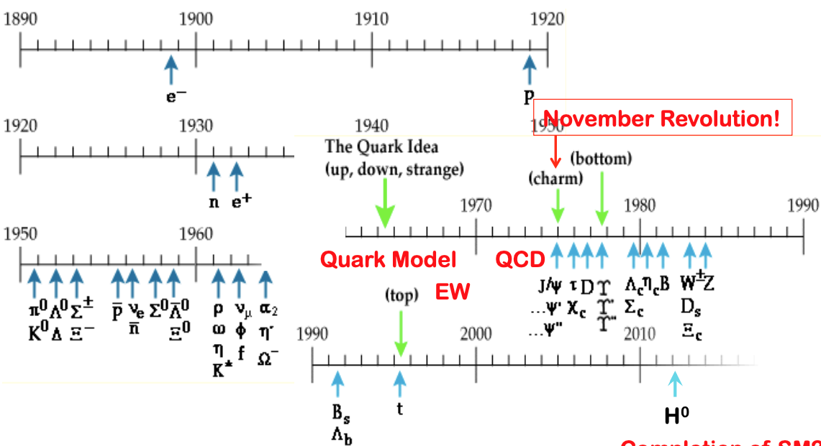
Hadron Spectrum

Slide 6
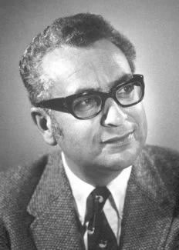
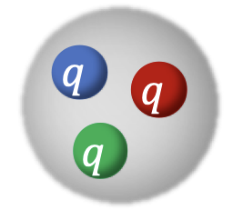
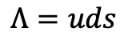
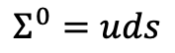
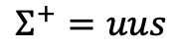
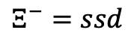
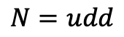
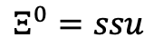

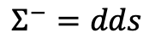
Constituent Quark Model
Many hadrons were discovered in 1950s and 1960s
The quark model was proposed by Gell-Mann and Zweig
Baryon are bound states of three quarks
For example: baryon octet
$$P=uud$$
$$N=udd$$
$$Σ^{+}=uus$$
$$Σ^{0}=uds$$
$$Λ=uds$$
$$Σ^{−}=dds$$
$$Ξ^{0}=ssu$$
$$Ξ^{−}=ssd$$

Slide 7
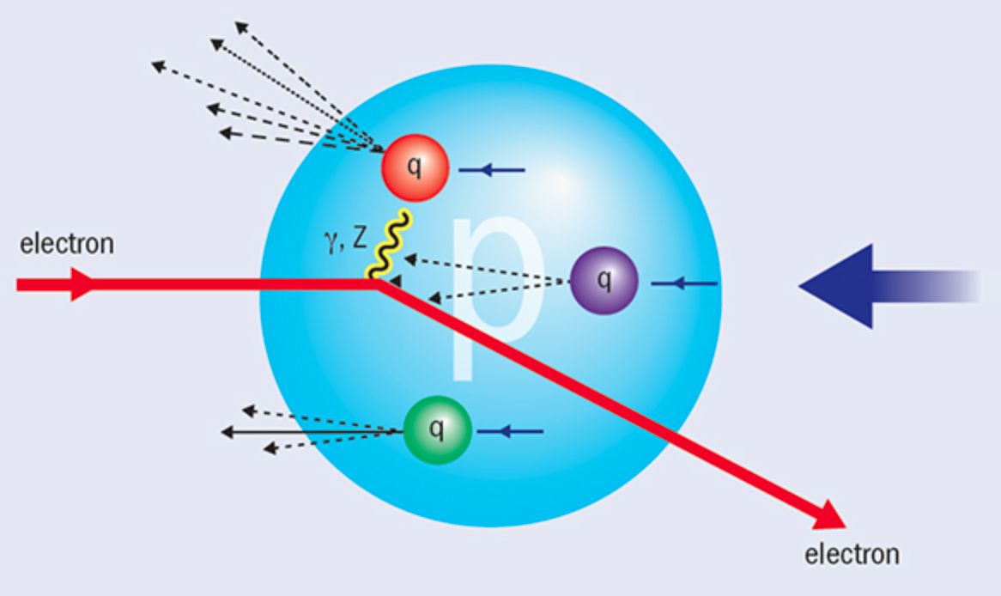
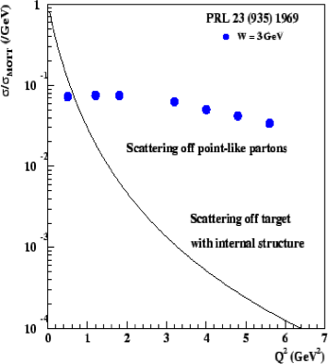
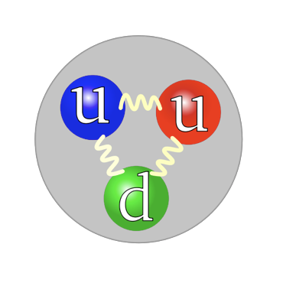
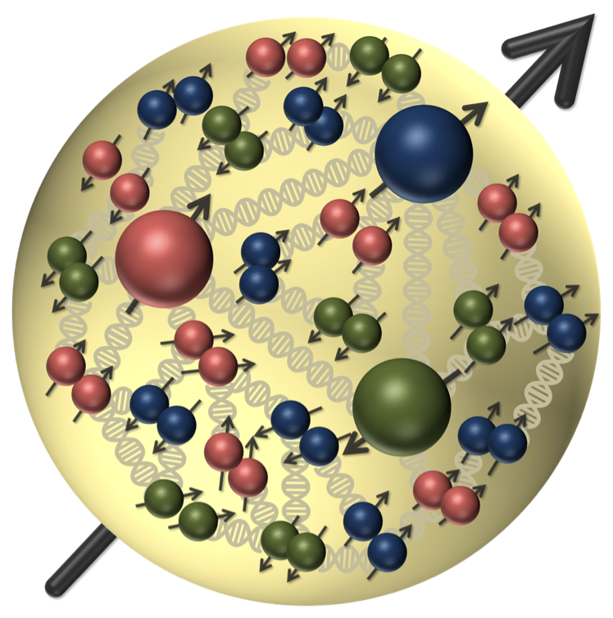
Deep Inelastic Scattering
Modern Rutherford Experiment – DIS (SLAC 1968)
Discovery of spin ½ quarks and partonic structure (sea quarks and gluons) in nucleon

Slide 8
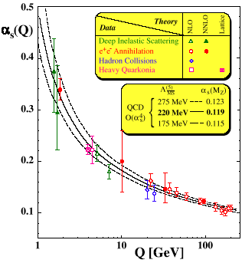
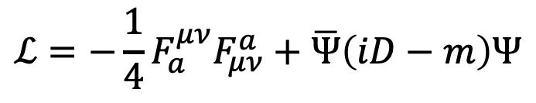

Theory for Strong Interaction
Quantum Chromodynamics (QCD): fundamental theory for strong interaction (1973)
Quark and gluons are bound
together by “color” charges
Interaction becomes stronger
as distance increases
asymptotic freedom
Nonperturbative approaches
are needed
$$ℒ=−\frac{1}{4}F_{a}^{μν}F_{μν}^{a}+\overline{Ψ}\left(iD−m\right)Ψ$$
$$/$$

Slide 9
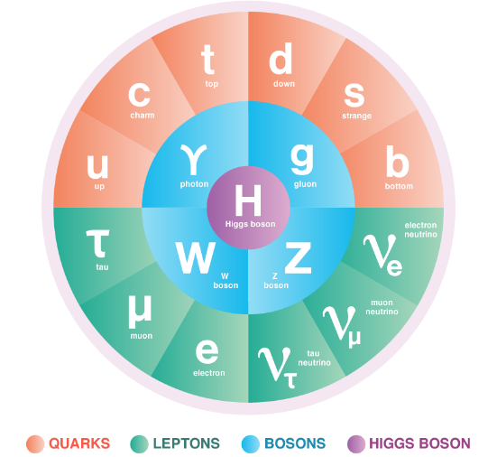
Standard Model
Yang-Mill Gauge theory
Quantum ChromoDynamics
Strong Interaction

Slide 10
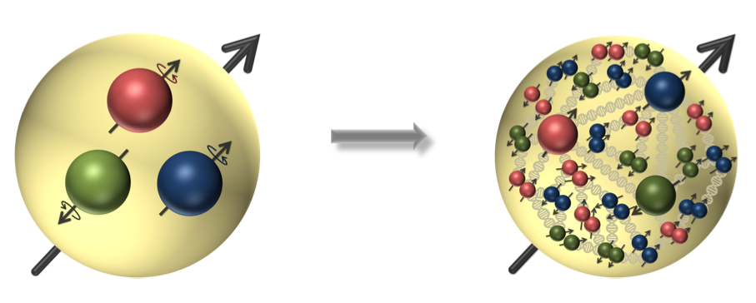
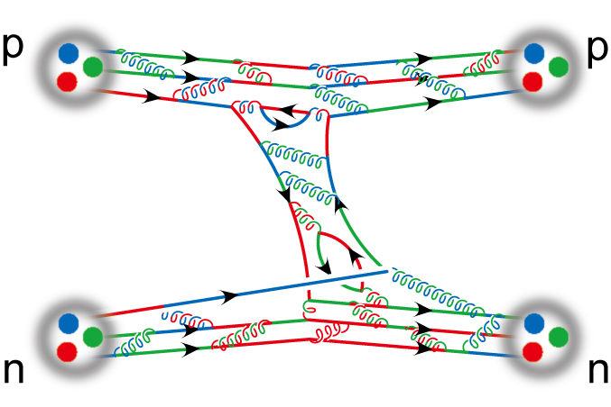
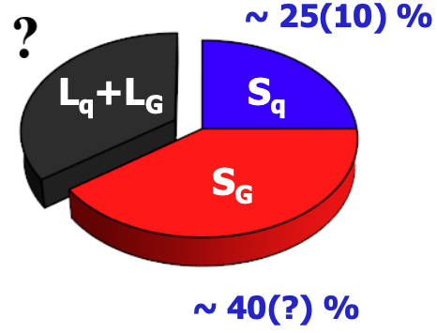
Hadron Structure
Origin of mass
Spin “crisis”
Nuclear force
Ortibal angular momentum

Slide 11
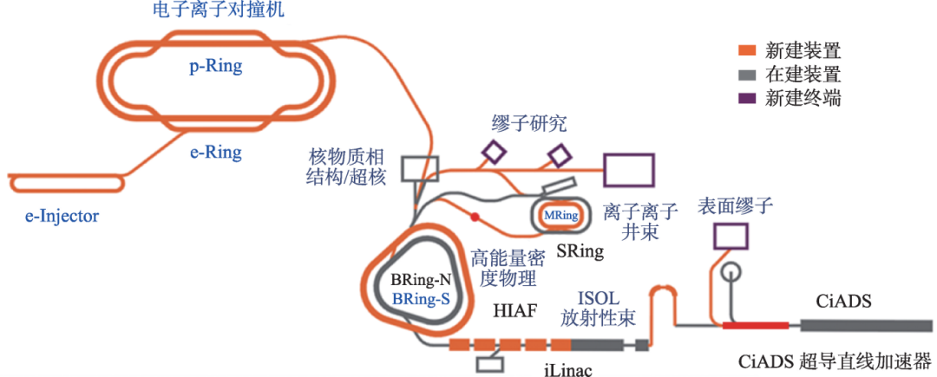
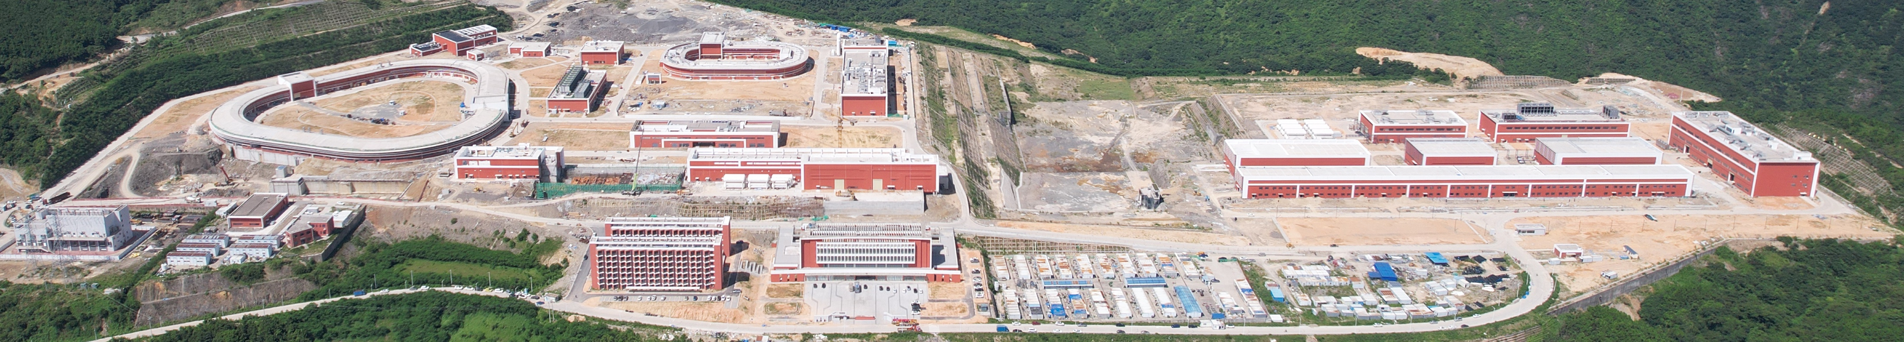

Electron-Ion Collider in China
Next Generation Large-scale Scientific Facility: Electon-Ion Colliders
[赵红卫. 从HIAF到CNUF[J].
现代物理知识, 2024, 36(1): 42-52.]
Unite the theoretical and experimental research
Accelerate the development of nuclear physics
2024.7 huizhou
Notes:
30秒

Slide 12


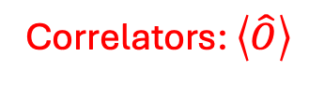


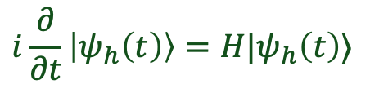
Non-Perturbative Approaches
Hadrons are the eigenstates of the QCD Hamiltonian
$$H|ψ_{h}〉=E_{h}|ψ_{h}〉$$
Lagrangian Formalism
Hamiltonian Formalism
Euclidean Space
Minkowski Space
Correlators: $\left\langle \hat{O}\right\rangle$
Wave Functions: $|ψ_{h}〉$
$$\left\langle \hat{O}\right\rangle =∫D_{ψ}\hat{O}e^{−S_{E}[ψ]}$$
$$H|ψ_{h}〉=E_{h}|ψ_{h}〉$$
$$i\frac{∂}{∂t}\left|ψ_{h}\left(t\right)\right\rangle =H|ψ_{h}\left(t\right)⟩$$
Approach: Lattice QCD, DS / BSE
Approach: DLCQ , BLFQ
Advantanges:
Covariant, gauge-symmetry
Advantanges:
Access to distributions, real-time
The Hamiltonian and Lagrangian approaches are complementary to each others.

Slide 13
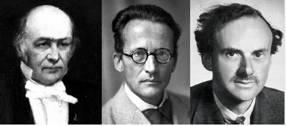
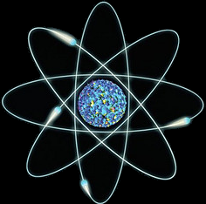
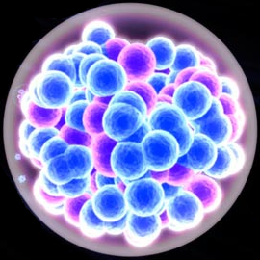
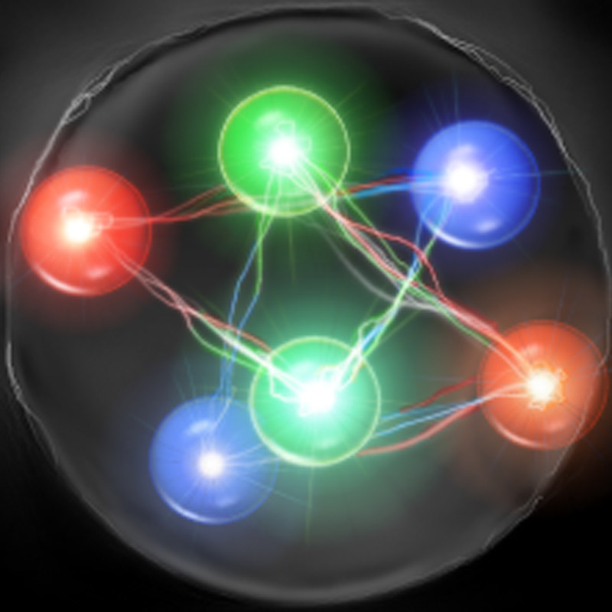
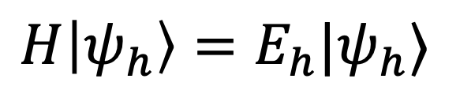
Hamiltonian Formalism
Stationary Schrödinger equation (Hamiltonian eigenequation ) universally describes bound-state structure
$$H|ψ_{h}〉=E_{h}|ψ_{h}〉$$
Eigenstates $|ψ〉$ encode full information of the system
Nonrelativistic
Nonrelativistic
Relativistic
atom
nucleus
nucleon

Slide 14

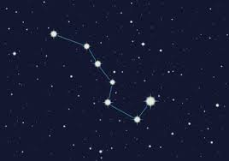
Light-front Time
How is the structure of relativistic bound states measured?
A more useful definition of time?

Slide 15
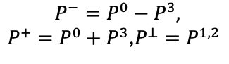
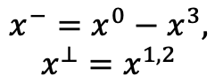
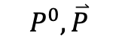
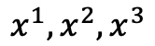
Light-front Quantization
Equal time quantization
Light-front quantization
[Dirac, 1949]
Time variable
Quantization surface
Coordinate space
$$x^{1},x^{2},x^{3}$$
$${x^{−}=x}^{0}−x^{3},$$
$$x^{⊥}=x^{1,2}$$
Momentum Space
$$P^{0},\overset{⃑}{P}$$
$${P^{−}=P}^{0}−P^{3},$$
${P^{+}=P}^{0}+P^{3}$,$P^{⊥}=P^{1,2}$
Dispersion relation
Notes:
Light front was first proposed by Dirac, at 1949.
1. First, what is light-front. Different from equal time theory. We define light-front time as a linear combination of the regular time and one of the spatial coordinate, usually we choose z direction.
So our field quantized at this equal light-front time plane. Where in equal time quantization, they quantized at this equal time plane.
X minus is longitudinal coordinate. P minus is light front Hamiltonian. P plus is longitudinal momentum.
This is light front version of schordinger equation.
Please note that it is not just a coodernate transformation, it is a new theory in a different quantization.
Why go to light front? For we can get Frame Independent wavefunction. Which encods all the information of the bound state structure. It has simple vacuum structure. The theory is boost invariant. And there is no square root in Hamiltonian p minus.

Slide 16
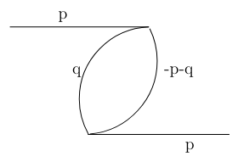
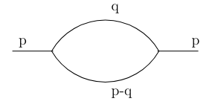
Main Advantages
Vacuum is simple
Energy denominator:
where
In infinite momentum frame:
As $p$ increases, the energy denominator of the second diagram decreases.

Slide 17
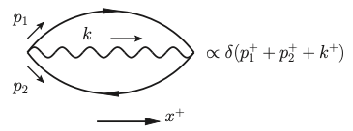

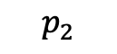
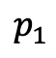
Main Advantages
1. Vacuum is simple
For on-shell particles, $k^{0}≥k^{3}$, so $k^{+}=k^{0}+k^{3}≥0$
$$p_{1}$$
$$k$$
$$p_{2}$$
For example, above diagram can exist in equal time field theory,
but cannot exist in light-front field theory.

Slide 18
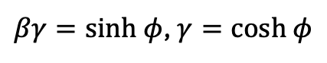

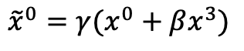
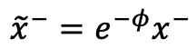
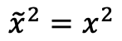
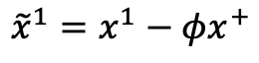
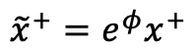
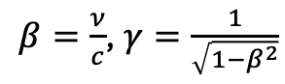
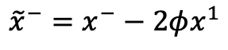
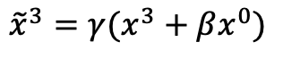

Main Advantages
2. Frame-independence
Lorentz boost transformation:
longitudinal:
$${\tilde{x}}^{0}=γ(x^{0}+βx^{3})$$
$${\tilde{x}}^{+}=e^{φ}x^{+}$$
$${\tilde{x}}^{3}=γ(x^{3}+βx^{0})$$
$${\tilde{x}}^{−}=e^{−φ}x^{−}$$
$β=\frac{ν}{c}$, $γ=\frac{1}{\sqrt{1−β^{2}}}$
$βγ=sinh φ$, $γ=cosh φ$
transverse boost:
$${\tilde{x}}^{+}=x^{+}$$
$${\tilde{x}}^{−}=x^{−}−2φx^{1}$$
$${\tilde{x}}^{1}=x^{1}−φx^{+}$$
$${\tilde{x}}^{2}=x^{2}$$
The boosts leave equal-light-front-time surfaces unchanged.
The boosts leave longitudinal momentum faction $x=\frac{p^{+}}{P^{+}}$ unchanged.

Slide 19


Main Advantages
3. Convenience for evaluating observables:
Observables for hadron structure are defined
on the light front
For examples:
Parton distribution functions:
$$Φ^{\left[γ^{+}\right]}\left(x,Q^{2}\right)=\int{\frac{dz^{−}}{8π}} e^{ixP^{+}z^{−}/2}⟨P,Λ\left|\overline{ψ}\left(z\right)γ^{+}ψ\left(0\right)\right|P,Λ⟩$$
Generalized Parton Distribution Functions (GPD)
$$Φ^{\left[γ^{+}\right]}\left(x,Δ;Q^{2}\right)=\int{\frac{dz^{−}}{8π}} e^{ixP^{+}z^{−}/2}⟨P+Δ,Λ\left|\overline{ψ}\left(z\right)γ^{+}ψ\left(0\right)\right|P,Λ⟩$$

Slide 20


Light-Front Field Theory
Challenges for relativistic bound states
Particle number
not Conserved
Quantum Field Theory
Light-Front Field Theory
Wave function not covariant
Light-Front Quantization
Light-front variables:
$x^{+}=x^{0}+x^{3}$ (light-front time),
${x^{−}=x}^{0}−x^{3}$, $x^{⊥}=x^{1,2}$
$${P^{−}=P}^{0}−P^{3}\text{(}\text{light}\text{−}\text{front} \text{Hamiltonian}\text{)},$$
${P^{+}=P}^{0}+P^{3}$, $P^{⊥}=P^{1,2}$
Advantage:
Frame-independent light-front wave functions
Observables are defined on the light-front
Need nonperturbative approach to light-front field theory!

Slide 21






Light-Front Wave Functions
$$H|ψ_{h}(P,Λ)〉=E_{h}|ψ_{h}(P,Λ)〉$$
Fock Space:
$$|\left.ψ_{h}\right\rangle =|\left.qqq\right\rangle +\left|qqqg\right\rangle +\left|qqq q\overline{q}\right\rangle + ⋅⋅⋅⋅⋅⋅$$
$$\left|ψ_{h}\left(P,Λ\right)\right\rangle =\sum_{n=1→∞}{∫dD_{n}ψ_{h/n}({\left\{{\overset{⃑}{k}}_{i⊥},x_{i},λ_{i}\right\}}_{n})}|{\left\{p_{i},λ_{i}\right\}}_{n}⟩$$
Momentum Space:
Light-front wavefunctions (LFWFs): $ψ_{h/n}\left({\left\{{\overset{⃑}{k}}_{i⊥},x_{i},λ_{i}\right\}}_{n}\right)=⟨{\left\{k_{i},λ_{i}\right\}}_{n}|ψ_{h}⟩$
Notes:
$$x_{i}=p_{i}^{+}/P^{+}$$
$${\overset{⃑}{k}}_{i⊥}={\overset{⃑}{p}}_{i⊥}−x_{i}{\overset{⃑}{P}}_{⊥}$$
$$H=P^{+}P^{−}−P_{⊥}^{2}$$
LFWFs are frame-independent and only depend on the intrinsic momenta

Slide 22




Basis Light-Front Quantization
Hamiltonian eigenvalue equation:
[Vary, et.al, Phys.Rev.C ’10]
$P^{−}$: Light-Front Hamiltonian
$|\left.β\right\rangle$: Eigenstates
$P_{β}^{−}$: Eigenvalues for eigenstates
$$P^{−}\left|\left.β\right\rangle =P_{β}^{−}\right|\left.β\right\rangle$$
Basis setup:
Fock sector expansion:
$$|\left.β_{nucleon}\right\rangle =|\left.qqq\right\rangle +\left|qqqg\right\rangle +\left|qqq q\overline{q}\right\rangle + ⋅⋅⋅⋅⋅⋅$$
Single particle basis
in $|qqq⟩$:
$$\left|α\right\rangle =|n_{1},m_{1},n_{2},m_{2},n_{3},m_{3}⟩$$
$$⨂ |k_{1}^{+}, k_{2}^{+},k_{3}^{+}⟩$$
$$⨂|λ_{1},λ_{2},λ_{3},C⟩$$
2-dimension harmonic oscillator
Discretized longitudinal momentum
Helicity and color
Basis truncation:
$$\sum_{i}{(2n_{i}+\left|m_{i}\right|+1)}≤N_{max}$$
$$\sum_{i}{k_{i}^{+}}=K_{max}$$
$$Λ=\sum_{i}{(λ_{i}+m_{i})}$$
Advantages:
1. Rotational symmetry in transverse plane
2. Exact factorization between center-of-mass motion and intrinsic motion
3. Harmonic oscillator basis supplies correct infrared behavior for hadrons

Slide 23
BLFQ Algorithm Flowchart
Enumerate Basis
Hamiltonian Matrix Generation
Diagonalize Hamiltonian Matrix
Light-Front Wave Functions
Distribution Functions
Such as Form Factors, PDFs, GPDs, TMDs

Slide 24













Light-front Hamiltonian
QCD light-front Hamiltonian can be derived from QCD Lagrangian:
$$ℒ_{QCD}=\overline{ψ}\left(iD−m\right)ψ−\frac{1}{4}G_{μν}^{α}G_{α}^{μν}$$
/
$$P_{QCD}^{−}=H_{K}+H_{I}$$
$$A^{+}=0$$
$$H_{K}=$$
$$H_{I}=$$
$ψ$: quark field operator
$A_{μ}^{a}$: gluon field operator
Notes:
Add Fock sector

Slide 25


Dimension of Basis States
Expansion in BLFQ basis
$$|\left.β_{baryon}\right\rangle =|\left.qqq\right\rangle +\left|qqqg\right\rangle +\left|qqq q\overline{q}\right\rangle +…$$
$$|\left.β_{meson}\right\rangle =|\left.q\overline{q}\right\rangle +\left|q\overline{q}g\right\rangle +\left|q\overline{q} q\overline{q}\right\rangle +…$$
$$\left|β_{deuterium}\right\rangle =\left|qqq qqq\right\rangle +\left|qqq qqq g\right\rangle +…$$
For the entire truncation parameters ($N_{max}=10$, $K_{max}$=16), the dimension of the Basis states with different Fock sector expansion

Slide 26


Dimension of Basis States
Expansion in BLFQ basis
$$N_{max}=K_{max}$$
Challenges: The basis size increases exponentially

Slide 27




Example: Proton Structure up to $|qqqq\overline{q}⟩$
$$\left|\left.P_{baryon}\right\rangle =Ψ_{1}\right|\left.qqq\right\rangle +Ψ_{2}\left|qqqg\right\rangle +Ψ_{31}\left|qqq u\overline{u}\right\rangle +Ψ_{32}\left|qqq d\overline{d}\right\rangle +Ψ_{33}\left|qqq s\overline{s}\right\rangle$$
$$P^{−}=H_{K.E.}+H_{Interact}$$
$$H_{K.E.}=\sum_{i}{\frac{p_{i}^{2}+m_{q}^{2}}{p_{i}^{+}}}$$
$$H_{Interact}=g\overline{ψ} γ^{μ}T^{a} ψ A_{μ}^{a}+\frac{g^{2}C_{F}}{2} j^{+}\frac{1}{{\left(i∂^{+}\right)}^{2}}j^{+}+\frac{g^{2}C_{F}}{2} \overline{ψ}γ^{μ}A_{μ}\frac{γ^{+}}{i∂^{+}}A_{ν}γ^{ν}ψ$$

Slide 28













Structure of Hamiltonian Matrix
Light-front Hamiltonian for baryon:
From QCD Lagrangian
$$|\left.qqq\right\rangle$$
$$|\left.qqqg\right\rangle$$
$$|\left.qqqq\overline{q}\right\rangle$$
$$|\left.qqq\right\rangle$$
$$H_{K}$$
$$H_{I}$$
$$|\left.qqqg\right\rangle$$
$$H_{K}$$
$$|\left.qqqq\overline{q}\right\rangle$$
$$H_{I}$$
$$H_{K}$$
Fock sector expansion:
$$|\left.β_{baryon}\right\rangle =|\left.qqq\right\rangle +\left|qqqg\right\rangle +\left|qqq q\overline{q}\right\rangle$$
Notes:
Add Fock sector

Slide 29













Parallel Scheme
Basis separation
Communicator
Processor 0
Processor 1
Processor 2
… …
$$qqq$$
$$qqq$$
$$qqq$$
$$qqqg$$
$$qqqg$$
$$qqqg$$
$$qqqq\overline{q}$$
$$qqqq\overline{q}$$
$$qqqq\overline{q}$$
… …
… …
… …
Distribute every Fock sector to every process, and keep the load balance
Hamiltonian matrix generation
Processor
1
Processor
2
Full hamiltonian
in
one processor
Processor
3
Processor
4

Slide 30


Diagonalize Hamiltonian
Numerically solve the eigenvalue equation
$$\left\langle β\left|α⟩⟨α\left|P^{−}\right|α⟩⟨α\right|β\right\rangle =P_{β}^{−}$$
$|α⟩$ is the BLFQ basis state
Distribute each Block to the corresponding processor
Storage the Hamiltonian matrix with compressed sparse column (CSC) format
The CSC format can decrease the time of communication between the different processor
The package (ARPACK-NG):
A collection of Fortran77 subroutines designed to solve large-scale eigenvalue problems.
Based on the Lanczos algorithm, when applied to the Hermitian matrices

Slide 31








Fock Sector Decomposition
$$\left|\left.P_{baryon}\right\rangle →\right|\left.qqq\right\rangle +\left|qqqg\right\rangle +\left|qqqu\overline{u}\right\rangle +\left|qqqd\overline{d}\right\rangle +\left|qqqs\overline{s}\right\rangle$$
Truncation parameter: $N_{max}=7$ and $K_{max}=16$
$$m_{u}$$ | $$m_{d}$$ | $$m_{f}$$ | $$g$$ | $$b$$ | $$b_{inst}$$
0.99 GeV | 0.94 GeV | 5.9 GeV | 3.0 | 0.6 GeV | 2.7 GeV
In five quark Fock sector, we use current quark mass
$$\left|qqqg\right\rangle$$
$$\left|qqq u\overline{u}\right\rangle$$
$$\left|qqq d\overline{d}\right\rangle$$
$$\left|qqq\right\rangle$$
$$\left|qqq s\overline{s}\right\rangle$$

Slide 32




Electromagnetic Form Factor
Elastic scattering of proton
[ R. Hofstadter, Nobel Prize 1961 ]
$$e\left(p\right)+h\left(P\right)→e\left(p^{′}\right)+h(P^{′})$$
Elastic electron scattering established the extended nature of the proton (proton radius).
The Fourier transformation of these form factors provide spatial distributions (charge and magnetization distributions).
$⟨ψ_{h}(P^{′})\left| J^{μ}\left(0\right) \right|ψ_{h}(P)⟩$=
$\overline{u}\left(P^{′}\right)\left[γ^{μ}F_{1}\left(q^{2}\right)+\frac{iσ^{μν}}{2m_{N}}q_{ν}F_{2}\left(q^{2}\right)\right]u(P)$
Dirac Form Factor
Pauli Form Factor

Slide 33




Electromagnetic Form Factors
Electromagnetic Radii
Charge radius
$$\sqrt{\left\langle r_{E}^{2}\right\rangle }=0.72±0.05 fm$$
$$\sqrt{{\left\langle r_{E}^{2}\right\rangle }_{exp}}={0.840}_{−0.002}^{+0.003} fm$$
Magnetic radius
$$\sqrt{\left\langle r_{M}^{2}\right\rangle }=0.73±0.02 fm$$
$$\sqrt{{\left\langle r_{M}^{2}\right\rangle }_{exp}}={0.849}_{−0.003}^{+0.003} fm$$

Slide 34





Parton Distribution Functions (PDF)
Deep Inelastic Scattering (SLAC 1968)
$$X$$
$$e\left(p\right)+h\left(P\right)=e^{′}\left(p^{′}\right)+X(P^{′})$$
$$X$$
Discovery of spin ½ quarks and partonic structure
Parton distribution functions (PDFs) are extracted from DIS processes.
$$Φ^{\left[γ^{+}\right]}\left(x,Q^{2}\right)=\int{\frac{dz^{−}}{8π}} e^{ixP^{+}z^{−}/2}⟨P,Λ\left|\overline{ψ}\left(z\right)γ^{+}ψ\left(0\right)\right|P,Λ⟩$$
PDFs encode the distribution of longitudinal momentum and polarization carried by the constituents

Slide 35







Deep Inelastic Scattering Cross Section
$$W_{μν}\left(q,p,S\right)=$$
$$\frac{1}{4π}∫d^{4}z e^{iq⋅z}⟨ψ_{h}\left(p,S\right)\left|J_{μ}^{†}\left(z\right)J_{ν}\left(0\right)\right|ψ_{h}\left(p,S\right)⟩$$
Optical theorem
$$x_{B}=\frac{Q^{2}}{2p⋅q}$$
DIS Limit: $Q^{2}=−q^{2}→ ∞$

Slide 36





Example: Collinear Factorization
Collinear Approximation ($Q \sim xp⋅n≫k_{T}$)
$$Q^{2}∼2xp⋅q$$
$$f_{q}\left(x,μ^{2}\right)=\int{\frac{p^{+}dy^{−}}{2π}e^{ixp^{+}y^{−}}\left\langle ψ_{h}\left(p\right)\right|{\overline{ψ}}_{q}\left(0\right)\frac{γ^{+}}{2p^{+}} ψ_{q}\left(y^{−}\right) |ψ_{h}\left(p\right)⟩}$$
$$|ψ_{h}\left(p\right)⟩$$
: a hadron state
The large momentum transfer $Q$ defines the direction of the light-front $n$.

Slide 37

LFWFs representation
For the Parton Distribution Functions:
Unpolarized PDFs:
$$f_{q/g}^{γ^{+}}\left(x,μ^{2}\right)=\sum_{λ_{i}}{∫Π_{i=1}^{n}\frac{d^{2}k_{⊥}dx_{i}}{{\left(2π\right)}^{3}x_{i}}ψ_{n}^{∗}\text{(}{\left\{{\overset{⃑}{k}}_{i⊥},x_{i},λ_{i}\right\}}_{n})ψ_{n}\left({\left\{{\overset{⃑}{k}}_{i⊥},x_{i},λ_{i}\right\}}_{n}\right)δ(x_{1}−x)}$$
Notes: Assume index 1 represent the struck partons
The Unpolarized PDFs represent the number density distribution of partons inside the hadron with respect to the momentum fraction

Slide 38

Unpolarized PDF
Unpolarized PDFs:
Particle number density distribution
Fitting the initial scale by comparing the second moment at experimental scale
Qualitative agreement with global fitting
$$μ_{0}^{2}=0.22±0.01 GeV^{2}$$

Slide 39


Unpolarized PDF
Gluon and sea quark distribution are calculated
Qualitative trend with various global fitting results

Slide 40


LFWFs representation
For the Parton Distribution Functions:
Unpolarized PDFs:
$$f_{q/g}^{γ^{+}}\left(x,μ^{2}\right)=\sum_{λ_{i}}{∫Π_{i=1}^{n}\frac{d^{2}k_{⊥}dx_{i}}{{\left(2π\right)}^{3}x_{i}}ψ_{n}^{∗}\text{(}{\left\{{\overset{⃑}{k}}_{i⊥},x_{i},λ_{i}\right\}}_{n})ψ_{n}\left({\left\{{\overset{⃑}{k}}_{i⊥},x_{i},λ_{i}\right\}}_{n}\right)δ(x_{1}−x)}$$
helicity PDFs:
$$f_{q/g}^{γ^{+}γ^{5}}\left(x,μ^{2}\right)=\sum_{λ_{i}}{∫Π_{i=1}^{n}\frac{d^{2}k_{⊥}dx_{i}}{{\left(2π\right)}^{3}x_{i}}λ_{1}ψ_{n}^{∗}\text{(}{\left\{{\overset{⃑}{k}}_{i⊥},x_{i},λ_{i}\right\}}_{n})ψ_{n}\left({\left\{{\overset{⃑}{k}}_{i⊥},x_{i},λ_{i}\right\}}_{n}\right)δ(x_{1}−x)}$$
Notes: Assume index 1 represent the struck partons
The helicity PDFs represent the helicity density distribution of partons inside the hadron with respect to the momentum fraction

Slide 41




Helicity PDF
helicity PDFs:
$$μ_{0}^{2}=0.22±0.01 GeV^{2}$$
DGLAP Evolution
[COMPASS, Phys. Lett. B 693, 227 (2010) ]
$$μ^{2}=5.00 GeV^{2}$$
[HERMES, Phys. Rev. D 71, 012003 (2005)]
Helicity PDFs encode information on spin contributions from parton to hadron
At $x<0.2$ region, helicity PDF of u quark more or less agree with global fitting data
Helicity PDF of d quark has a good agreement with global fitting results

Slide 42










Helicity PDF
Spin decomposition
[Jaffe and Manohar, (1990)]
$$\frac{1}{2}=\frac{1}{2}ΔΣ+ΔG+L_{q}+L_{g}$$
$$ΔΣ_{u}=0.82$$
$$ΔΣ_{d}=−0.20$$
$$ΔG=0.06$$
$$ΔΣ_{\overline{u}}=0.008$$
$$ΔΣ_{\overline{d}}=0.008$$
$$ΔΣ_{s}=ΔΣ_{\overline{s}}=0.007$$
[JAM, Phys. Rev. Lett. 119, 132001 (2017)]
[NNPDF, Nucl. Phys. B 887, 276 (2014)]

Slide 43








LFWFs representation
For the Parton Distribution Functions:
Unpolarized PDFs:
$$f_{q/g}^{γ^{+}}\left(x,μ^{2}\right)=\sum_{λ_{i}}{∫Π_{i=1}^{n}\frac{d^{2}k_{⊥}dx_{i}}{{\left(2π\right)}^{3}x_{i}}ψ_{n}^{∗}\text{(}{\left\{{\overset{⃑}{k}}_{i⊥},x_{i},λ_{i}\right\}}_{n})ψ_{n}\left({\left\{{\overset{⃑}{k}}_{i⊥},x_{i},λ_{i}\right\}}_{n}\right)δ(x_{1}−x)}$$
$$P$$
$$P$$
$$S_{⊥}$$
$$S_{⊥}$$
$$S_{⊥}$$
$$S_{⊥}$$
Transversity PDFs:
$$f_{q/g}^{iσ^{+⊥}γ^{5}}\left(x,μ^{2}\right)=\sum_{λ_{i}}{∫Π_{i=1}^{n}\frac{d^{2}k_{⊥}dx_{i}}{{\left(2π\right)}^{3}x_{i}}ψ_{n}^{∗}\text{(}{\left\{{\overset{⃑}{k}}_{i⊥},x_{i},λ_{i}\right\}}_{n};Λ)ψ_{n}\left({\left\{{\overset{⃑}{k}}_{i⊥},x_{i},λ_{i}^{′}\right\}}_{n};Λ′\right)δ(x_{1}−x)}$$
Notes: index 1 represents the struck parton
$Λ^{′}=−Λ$, $λ_{1}=−λ_{1}$,
$$λ_{i≠1}^{′}=λ_{i≠1}$$
Transversity PDFs represent the spin density distribution of partons in transverse direction inside the hadron with respect to the momentum fraction

Slide 44







Transversity PDFs
$$P$$
$$P$$
$$δu=0.81±0.08$$
$$S_{⊥}$$
$$S_{⊥}$$
$$S_{⊥}$$
$$S_{⊥}$$
Tensor Charge:
$$δd=−0.22±0.01$$
There is no accurate definition of transversity PDFs for gluon.
The scale evolution can not include the gluon contribution

Slide 45





3D Structure in Coordinate Space
Deeply Virtual Compton Scattering (DVCS)
[X. Ji, Phys. Rev. D 55, 7114 (1997)]
$$e\left(p\right)+P\left(P\right)→e^{′}\left(p^{′}\right)+P^{′}\left(P^{′}\right)+γ$$
Generalized Parton Distribution Functions (GPD)
$$Φ^{\left[γ^{+}\right]}\left(x,Δ;Q^{2}\right)=\int{\frac{dz^{−}}{8π}} e^{ixP^{+}z^{−}/2}⟨P+Δ,Λ\left|\overline{ψ}\left(z\right)γ^{+}ψ\left(0\right)\right|P,Λ⟩$$
Encode the information about three-dimensional spatial structure of a hadron

Slide 46




GPDs for Valence Quarks
Preliminary
$u$ and $d$ quark GPDs (contributions from all Fock sectors)
$E_{u}$ has positive distribution while $E_{d}$ is negative, consistent with Dirac FF

Slide 47





GPDs for Gluon and Sea Quarks
Preliminary
Gluon and $s$ quark GPDs
$E_{s}$ mainly contributes at small $x$ region

Slide 48









GPDs for Sea Quarks
$$H_{\overline{u}}$$
$$E_{\overline{u}}$$
Preliminary
$$H_{\overline{d}}$$
$$E_{\overline{d}}$$
$\overline{u}$ and $\overline{d}$ GPDs are concentrated in small-x region
$\overline{u}$ and $\overline{d}$ GPD $E$ have small negative region around $x\sim 0.2$

Slide 49



Angular Momentum
d | u | dbar | ubar | s/sbar | g
-0.0636 | 0.9882 | 0.0063 | 0.0063 | 0.0028 | 0.0537
$u$ is dominant, gluon contributes about 5%, d is negative
Sea quarks contributes small because they concentrate at small x
d quark is almost the same as u in sea quark

Slide 50


Transverse Radius
Valence quarks occupy core region
Gluon radius > sea quark radius > valence quark radius
As $x→1$, nucleon behaves like point particle

Slide 51





3D Structure in Momentum Space
Semi-inclusive Deep Inelastic Scattering (SIDIS)
$$e\left(p\right)+h\left(P\right)→e^{′}\left(p^{′}\right)+h^{′}\left(P^{′}\right)+X$$
electron
h
h’
Transverse-momentum-dependent Parton Distribution Functions (TMD PDFs):
$$Φ^{\left[Γ\right]}\left(x,p_{⊥};Q^{2}\right)=\int{\frac{dz^{−}d^{2}z^{⊥}}{2{\left(2π\right)}^{3}}} e^{\frac{ixP^{+}z^{−}}{2}−ip_{⊥}z^{⊥}}⟨P,Λ\left|\overline{ψ}\left(z\right)γ^{+}ψ\left(0\right)\right|P,Λ⟩$$
Probability for finding a parton in a hadron with momentum fraction x and transverse momentum k_{T}
[R. Boussarie et al., TMD Handbook, arXiv:2304.03302 [hep-ph] (2023)]

Slide 52





TMDs for Valence and Sea Quarks
Small x behavior is contributed by $|qqqq\overline{q}⟩$

Slide 53



TMDs for Sea Quarks and Gluon
Strange and anti-strange quarks are peaked in the small-x region

Slide 54

Average Transverse Momentum Distribution
Total contributions from $\left|qqq\right\rangle +\left|qqq g\right\rangle +\left|qqqq\overline{q}\right\rangle$
In small-x region, average transverse momentum of gluon is larger than quark
In large-x region, gluon distribution is almost same with quark distributions

Slide 55



Generalized Transverse-Momentum-Dependent Parton Distribution Function
$$W_{λλ^{′}}^{\left[Γ\right]}\left(P,k,Δ,N;η\right)=\frac{1}{2}\int{\frac{d^{4}z}{{\left(2π\right)}^{4}}e^{ik⋅z}⟨ψ_{h}\left(p^{′},λ^{′}\right)\left|\overline{ψ}\left(−\frac{1}{2}z\right)ΓW\left(−\frac{1}{2}z,\frac{1}{2}z | n\right)ψ\left(\frac{1}{2}z\right)\right|ψ_{h}(p,λ)⟩}$$
The Definition of the Distribution Functions
$W_{λλ^{′}}^{\left[Γ\right]}\left(P,x,{\overset{⃑}{k}}_{⊥},Δ,N;η\right)=∫dk^{−}$ $W_{λλ^{′}}^{\left[Γ\right]}\left(P,k,Δ,N;η\right)$
$$=\frac{1}{2}\int{\frac{dz^{−}d^{2}{\overset{⃑}{z}}_{⊥}}{{\left(2π\right)}^{3}}e^{ik⋅z}⟨ψ_{h}\left(p^{′},λ^{′}\right)\left|\overline{ψ}\left(−\frac{1}{2}z\right)ΓW\left(−\frac{1}{2}z,\frac{1}{2}z | n\right)ψ\left(\frac{1}{2}z\right)\right|ψ_{h}(p,λ)⟩}{\left.​\right|}_{z^{+}=0}$$
GPDs
TMDs
$$F_{λλ^{′}}^{\left[Γ\right]}\left(P,x,N\right)=∫dk^{−}d^{2}{\overset{⃑}{k}}_{⊥}W_{λλ^{′ }}^{\left[Γ\right]}(P,k,Δ,N;η)$$
$$φ_{λλ^{′}}^{\left[Γ\right]}\left(P,x,{\overset{⃑}{k}}_{⊥},N;η\right)=∫dk^{−}W_{λλ^{′ }}^{\left[Γ\right]}(P,k,Δ=0,N;η)$$
PDFs
$$f_{λλ^{′}}^{\left[Γ\right]}\left(P,x,N\right)=∫dk^{−}d^{2}{\overset{⃑}{k}}_{⊥}W_{λλ^{′ }}^{\left[Γ\right]}(P,k,Δ=0,N;η)$$

Slide 56


Generalized Transverse-Momentum-Dependent Parton Distribution Function
$$W_{λλ^{′}}^{\left[Γ\right]}\left(P,k,Δ,N;η\right)=\frac{1}{2}\int{\frac{d^{4}z}{{\left(2π\right)}^{4}}e^{ik⋅z}⟨ψ_{h}\left(p^{′},λ^{′}\right)\left|\overline{ψ}\left(−\frac{1}{2}z\right)ΓW\left(−\frac{1}{2}z,\frac{1}{2}z | n\right)ψ\left(\frac{1}{2}z\right)\right|ψ_{h}(p,λ)⟩}$$
The Definition of the Distribution Functions
$W_{λλ^{′}}^{\left[Γ\right]}\left(P,x,{\overset{⃑}{k}}_{⊥},Δ,N;η\right)=∫dk^{−}$ $W_{λλ^{′}}^{\left[Γ\right]}\left(P,k,Δ,N;η\right)$
$$=\frac{1}{2}\int{\frac{dz^{−}d^{2}{\overset{⃑}{z}}_{⊥}}{{\left(2π\right)}^{3}}e^{ik⋅z}⟨ψ_{h}\left(p^{′},λ^{′}\right)\left|\overline{ψ}\left(−\frac{1}{2}z\right)ΓW\left(−\frac{1}{2}z,\frac{1}{2}z | n\right)ψ\left(\frac{1}{2}z\right)\right|ψ_{h}(p,λ)⟩}{\left.​\right|}_{z^{+}=0}$$

Slide 57
Conclusion
Light-front quantization: approach to structure of relativistic bound states
Solving nucleon structure like solving atomic structure
Hamiltonian framework: accessible to hadron wave functions
Basis Light-front Quantization
Nonperturbative approach to light-front dynamics
Preserve rotational symmetry in transverse plane (2d HO basis)
Preserve symmetries for identical particles (single particle basis)
Rich information on three-dimensional structure of hadron from light-front quantization
Valence quark, sea quark and gluon
Various polarization configurations for partons/hadrons
Higher-twist distributions (correlation between partons)
Golden time for investigating the proton structure
Electron-ion colliders are being built/planned
High-performance computing technologies are advancing

Slide 58
OutLook
First principles calculation of proton structure
More/higher Fock sectors included
Excited nucleon states/other hadrons/light nuclei
Reaction dynamics accessed through time-dependent light-front Schrödinger equation

Slide 59


Slide 60
Thanks you

